Slide 1

Map & Diagram Labelling | Follow Directions Without Getting Lost
Notes:
“In the previous video, we covered form, note, and table completion.”
“Now we’ll move to a Listening task that requires both listening and visual tracking.”
Map and diagram questions can feel stressful—especially when the speaker talks quickly and uses unfamiliar directions.
Many candidates actually understand the words, but still end up choosing the wrong location.
This usually happens because they lose track of the directions or fail to visualize the map clearly.
In this video, you’ll learn simple and effective strategies to follow directions step by step, stay focused while listening, and label maps and diagrams with confidence.
“Hello, my name is April Ampong, and I’m an instructor at IELTS NINER REVIEW CENTER— an international-standard IELTS training system that helps learners progress from beginner level to Band 7.0–9.0 in the most time-efficient way.”

Slide 2
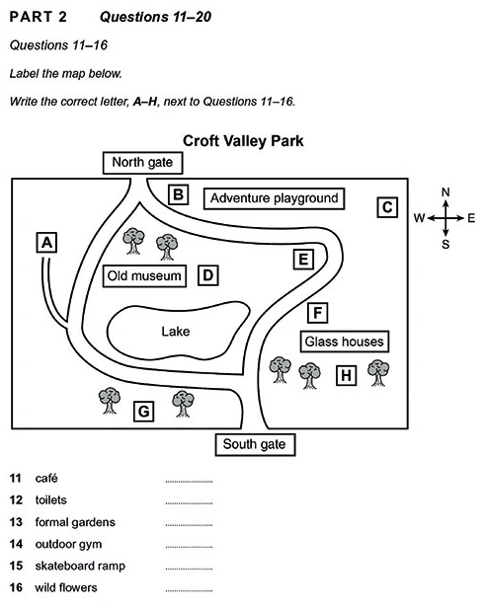
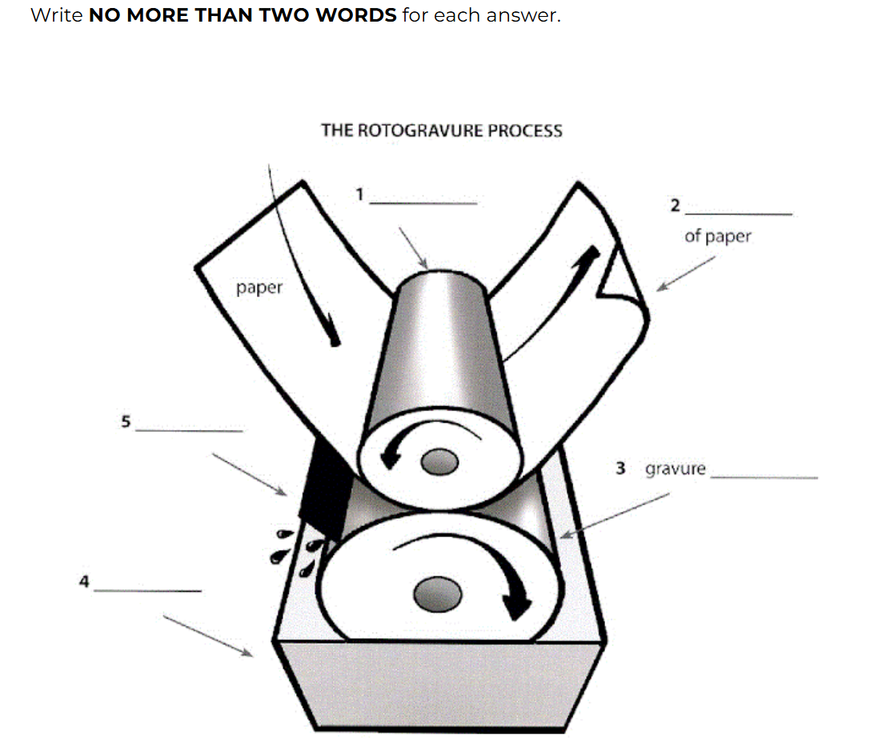
What Are Map & Diagram Labelling Questions
Notes:
Map and diagram labelling questions usually appear in Section 2 of the Listening test.
In this type of question, you are typically given either a map of a place, or a diagram of a building, a room, or even a process.
Your task is to listen carefully to the speaker’s directions and identify the correct locations on the map or diagram.
This means you need to understand both the language used and the movement described, so you can choose the correct answer accurately.

Slide 3
Study the Map Before Listening
Before the audio starts, take time to:
Identify the starting point
Notice key landmarks
Understand the orientation
Ask yourself:
Where is north?
Is this an indoor or outdoor map?
This preparation is essential.
Notes:
Before the audio starts, take a few seconds to prepare carefully.
First, identify the starting point, as this is where the speaker will begin giving directions.
Next, notice any key landmarks, such as entrances, roads, or important buildings, which will help you follow the route more easily.
Then, make sure you understand the orientation of the map.
Ask yourself questions like: Where is north? Is this an indoor or outdoor map?
This preparation is essential, as it allows you to stay focused and follow the directions more accurately during the listening.

Slide 4
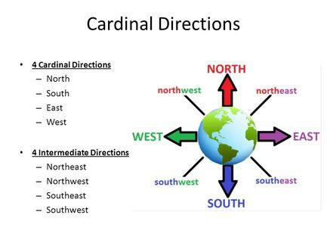
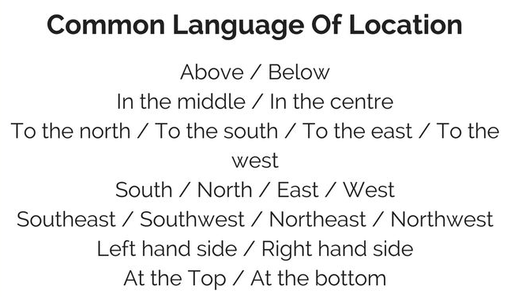
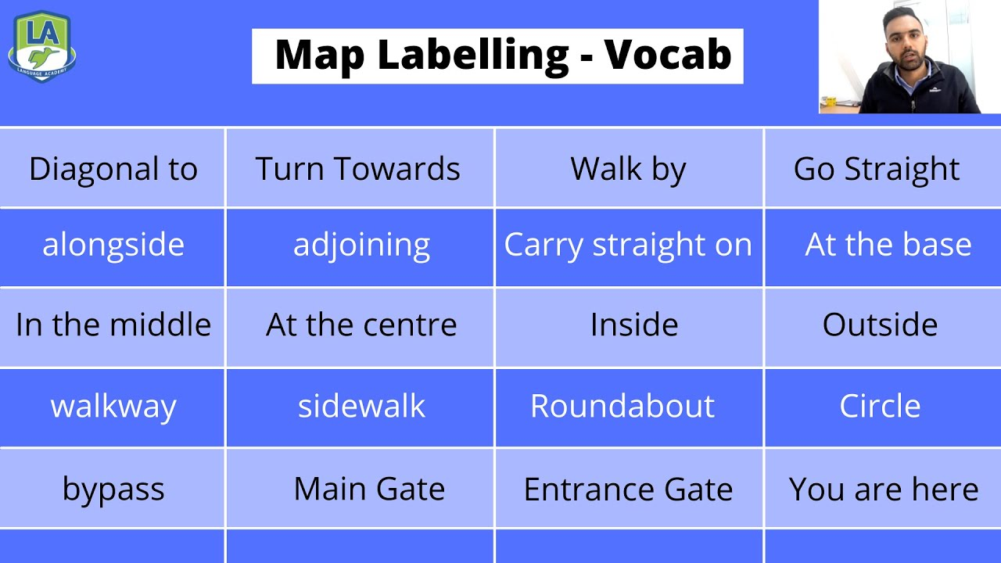
Listen for Directional Language
Notes:
IELTS uses very specific directional language, and understanding these phrases is essential for getting the correct answers.
Common expressions include: “on the left” and “on the right,” “opposite” and “next to,” “across from,” “at the end of,” as well as “go past” and “turn into.”
These phrases describe position and movement, so you need to recognize them quickly while listening.
Train your ear to identify these expressions instantly, so you can follow the speaker’s directions without hesitation.

Slide 5
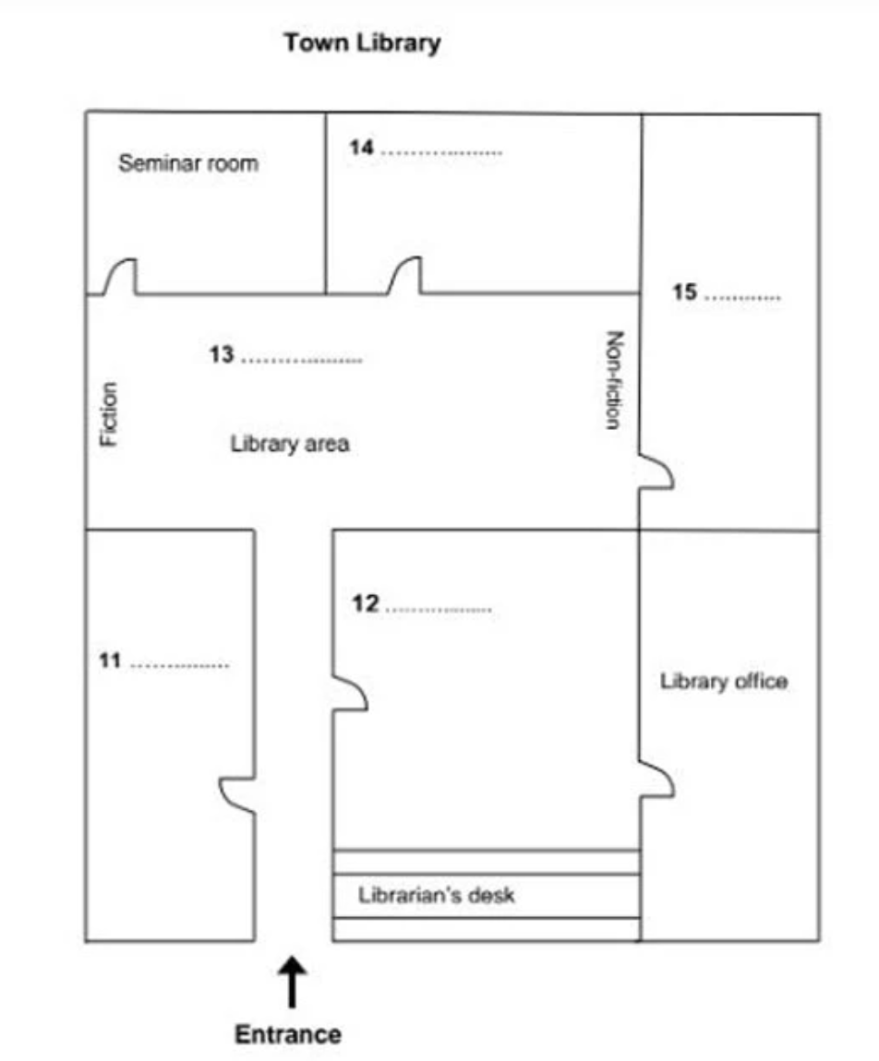
Follow the Route, Not Individual Words
Follow me
YOU ARE HERE
Notes:
Think of the audio as a guided tour, where the speaker is leading you through the map step by step.
As you listen, imagine that you are physically moving through the المكان, following the same path described by the speaker.
This will help you stay engaged and understand the directions more clearly.
It is important to follow the movement carefully and track each instruction as it is given.
Pay attention to every change in direction, such as turning left, going straight, or passing a specific location.
At the same time, avoid jumping ahead on the map. Many students try to guess the answer too early, which often leads to mistakes.
Instead, stay patient and let the speaker finish the full set of directions.
Remember, the correct answer usually comes after a sequence of instructions, not immediately after the first clue. Missing even one step can lead you to the wrong place.
A useful tip is to use your finger or pencil to trace the route on the map while you listen. This can help you stay focused and reduce confusion.
By staying calm, following each step carefully, and visualizing the movement, you will be able to answer map and diagram questions more accurately and with greater confidence.

Slide 6

Advice from IELTS NINER REVIEW CENTER
At IELTS NINER REVIEW CENTER, we teach students to:
Use their finger or pencil to trace the route
Stay calm and move slowly
Focus on the journey, not just the destination”
This technique prevents most map-labeling mistakes.”
Notes:
At IELTS NINER REVIEW CENTER, we teach students simple but highly effective techniques to handle map and diagram questions with confidence.
First, use your finger or a pencil to trace the route as you listen. This helps you stay focused and follow each step of the directions more accurately.
Second, stay calm and move slowly. There is no need to rush—most mistakes happen when students panic or try to guess too quickly.
Finally, focus on the journey, not just the destination. Pay attention to every step the speaker describes, because each detail leads you closer to the correct answer.
This technique is simple, but very powerful, and it can prevent most common map-labelling mistakes.

Slide 7
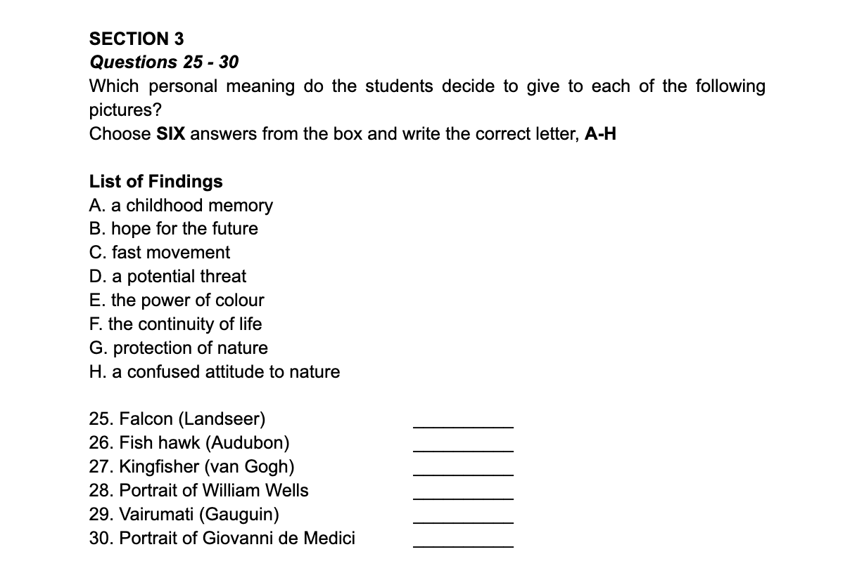
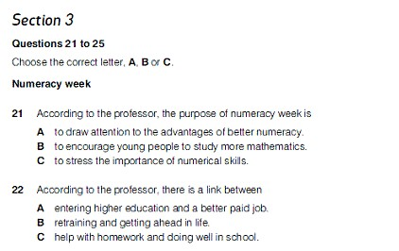
Add a Slide Title - 1
Notes:
“Now that you can follow directions visually, it’s time to deal with a more complex challenge.”
“In the next video, we’ll focus on: 👉 Section 3 of IELTS Listening—academic discussions and how to follow multiple speakers.”
“See you in the next video.”

Slide 8
Add a Slide Title - 2

Slide 9
Add a Slide Title - 3

Slide 10
Add a Slide Title - 4

Slide 12
Add a Slide Title - 5

